Slide 1

BRITISH AIRWAYS SENTIMENT ANALYSIS OF CUSTOMER REVIEWS
MATHIAS KAMYA

Slide 2
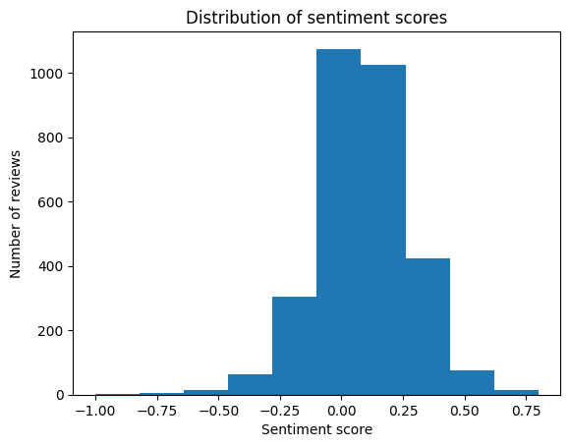
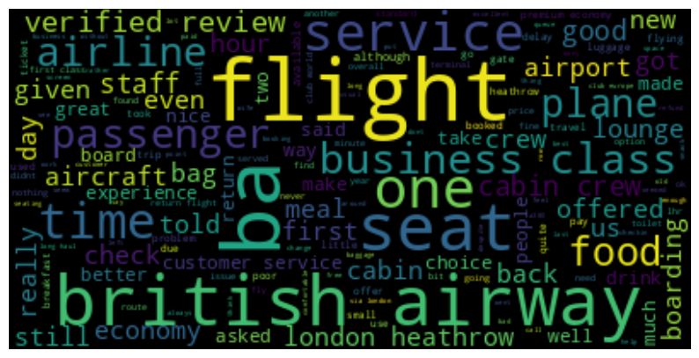
Sentiment score: 0.08 (slightly positive)
Distribution of sentiment scores:
Common topics:
Great
Nice
Poor
Delay
Notes:
Recommendations:
Continue to monitor customer reviews to identify any emerging trends or concerns
Focus on improving the customer experience in areas where customers have expressed dissatisfaction

